Slide 1
Utah State University Title IV-E Program
IV-E Roundtable Conference
June 2015
Derrik Tollefson

Slide 2
Background
Need for professionalized CW staff
Public child welfare staff must possess higher knowledge and skill levels if they are to be effective.
If effective services are to be delivered, professionals who have appropriate educational and training backgrounds and have the necessary values, knowledge and skills to serve culturally and ethnically diverse client populations are needed at all levels of the child welfare system.
Unfortunately, many staff are not adequately prepared for the difficult work.
The difficult working conditions found within the public child welfare system have resulted in high staff turnover.

Slide 3
CB Project Overview
Goal:
We propose to increase the Utah Division of Child and Family Services’ (DCFS) ability to respond in a competent manner to the complex problems confronting the children and families it serves through the provision of child welfare-specific, competency-based training to current and prospective BSW-level public child welfare staff.

Slide 4
CB Project Overview
Objectives
1- Reforming and developing child welfare specific curriculum within existing BSW programs through a collaboration between the state’s two largest public universities leading to the delivery of competency-based child welfare courses that teach to the critical knowledge, values, and skills required by today’s public child welfare staff,
2- Increasing the number of public child welfare (DCFS) field placements through traineeships, and
3- Improving the quality of supervision of students in public child welfare (DCFS) field placements through intensive field instructor training and support.

Slide 5
Project Evolution
Children’s Bureau 5-yr Grant
Spawned Development of IV-E at USU
U. of Utah IV-E Program already existed
IV-E Initiative is ongoing
CB trainees required to take 2 courses during jr and sr years plus CW practicum

Slide 6
Curriculum Development
Project Advisory Board
CW experts
Literature Review focused on competencies
Course and Curriculum Design
Competencies provided direction
Instructor flexibility

Slide 7
Curriculum Delivery
Collaboration
Distance Education Technology
Interactive Video Conference and Canvas
Field Practicum Instructor Training and Support

Slide 8
Curriculum Delivery Options

Slide 9
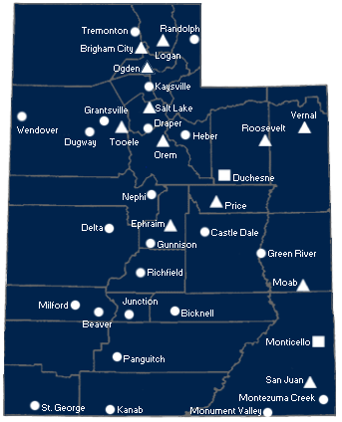
USU Locations in Utah

Slide 10
Recruitment/Stipends
MSW Stipends $5280 (per semester, 3 yrs)
Must already be a DCFS employee
BSW Stipends $6700 (senior yr)
12-mo. Commitment
Released if not offered job w/in 90 days

Slide 11
Courses
Child Welfare: Overview of Policies and Practices
Child Welfare Theories (HBSE)*
Forensic Child Welfare
Advanced Child Welfare Practice: working with diverse and multi-problem families
Field Practicum Seminar

Slide 12
Child Welfare (Overview) Course
Course Objectives
To discuss the history of children’s services in U. S. society.
To acquaint students with the issues and problems that impact children and their families in the U. S.
To review the current availability of resources related to children’s needs.
To provide the opportunity for students to become familiar with key social service providers from community child welfare agencies.
To acquaint students with generalist social work skills and procedures applicable to child welfare practice.
To help students understand issues of cultural and ethnic diversity as they relate to children’s services.

Slide 13
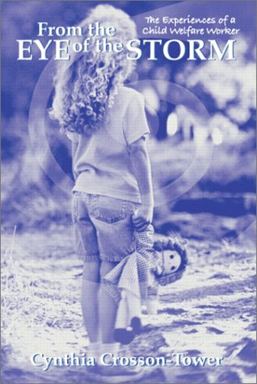
Child Welfare Overview Course
Learning Activities/Tools

Slide 14
Child Welfare Overview Course
Learning Activities
Lecture & Guest Speakers
Reading Quizzes
Five unannounced reading quizzes (25 pts. Each) given during the term.
“Eye of the Storm” Questions
Students are required to read “From the Eye of the Storm: The experiences of a child welfare worker” by Crosson-Tower and answer the questions at the end of each chapter.

Slide 15
Child Welfare Theory Course Objectives
Strengthen students’ capacities to understand the developmental impacts of trauma related to adverse childhood events , notably, the challenges experienced by children who are served by the child welfare system.
Provide exposure to the knowledge, skills, and values needed to identify and respond proactively to threats to the healthy development of children.
Increase students’ abilities to apply systems theory, developmental theory and other frameworks to assessment and intervention in the child welfare services context.

Slide 16
Learning Activities
“First person” autobiographical child welfare reading experiences:
Somebody’s Someone
The Lost Boy
On Their Own
Group discussions and writing assignments:
Identification and evidence of trauma and core emotional issues involved in these experiences
Application of PIE, developmental, systems, and attachment theories
“Added” benefits for students:
Empathy and understanding
Preparation for vicarious traumatization

Slide 17
Learning Activities
Guest speakers from the child welfare community:
Foster-Adoption Domestic Violence
Child Abuse Prevention Mental Health
Early Intervention Transition to Adult Living
Disabilities Substance Abuse
Trauma and Brain Development Etc. etc.
“Added” Benefits: Resource understanding, networking—some students made employment connections!

Slide 18
Learning Activities
Group research projects on the developmental implications of childhood trauma:
Research on theory and interventions focused on students’ chosen area of vulnerability for children
Research paper and formal presentations on literature review, application, and implications for social work practice
Benefits:
Building an area of expertise, negotiating the group process, pursuing an area of passion.

Slide 19
Advanced Child Welfare Practice
This advanced practice course builds on the student’s social work knowledge and values base to identify, explore, and engage in the practice skills needed to successfully work with children and families.
Students explore and learn to work with situations involving:
Clients who are generally involuntary and resistant;
Clients whose lives are impacted by violence, abuse and lack of resources; and
Where the social work role is often formulated through Federal and State regulation.

Slide 20
Advance Child Welfare Practice: Overall Goal
The overall goal is for the student to become proficient in team-building and collaboration skills, enhancing family continuity, and engaging in effective planning and contracting strategies.

Slide 21
Advance Child Welfare Practice: Competencies Addressed
Knowledge of significant historical events in child welfare services and how events have influenced the current state of child welfare programs and policies.
Ability to work with biological families to make and effect a permanent plan for a child in care (involves the ability to promote permanency for children through reunification with biological parents, kinship care, or adoption).
Ability to function as a case manager, and as a service team member, and collaborate with other service providers on behalf of the child/family. Involves linking families to community resources, and the ability coordinate the services of multiple providers.
Ability to assess the developmental impacts of adverse childhood events of children served in the child welfare system.
Knowledge of comprehensive array of resources needed to meet the needs of families and children in the child welfare system as a result of historical and contemporary challenges.

Slide 22
Advance Child Welfare Practice: Competencies Addressed
Ability to engage a family (or youth) in a strengths-based, family centered assessment process.
Ability to work together with a family to develop and implement a service agreement with clear goals, strategies, timeframes, and desired outcomes.
Ability to provide crisis intervention, parenting skills training, family counseling, conflict resolution, and individual and group work, in a variety of settings.
Ability to work effectively in the juvenile court system, including providing clearly written documentation for court and to testify in court proceedings in support of agency legal intervention.
Ability to work with children and adolescents at various developmental stages and with a wide range of needs, applying knowledge of human behavior and intervention skills.

Slide 23
Advance Child Welfare Practice: Learning Assignment 1
Philosophical and Political Context of Child Welfare Practice
Students have the option of choosing one of four (4) possible assignments to address learning objectives for this assignment:
A Legislative Analysis Paper. Students choose a significant child welfare legislative act, and write a paper the Act and it’s impact on child welfare services. This includes:
a brief summary of the selected legislative act;
assessment/opinion of the intended consequences of the act;
assessment of what positive things have happened (if any) for children’s services as a result of the act;
assessment of what negative things have happened (if any) for children’s services as a result of the act; and
personal opinion of the success of this act according to it’s intended consequences.
Legislative Impact Interview. Students conduct a 30-45 minute interview with an instructor or professor in the school of social work or in the social work professional community who has a background in policy and/or macro practice social work. Students request the interviewee discuss the impact of legislation on child welfare services. Students complete a written analysis of the interview, and submit the audio/video tape as well.

Slide 24
Advance Child Welfare Practice: Learning Assignment 1
Philosophical and Political Context of Child Welfare Practice
Students have the option of choosing one of four (4) possible
assignments to address learning objectives for this assignment:
Legislative Impact Interview. Students conduct a 30-45 minute interview with a social worker currently working in the field of child welfare. Interviewee is asked to discuss how “higher level” child welfare policies impact the actual day-to-day provision of services “in the field”. Students complete a written analysis of the interview, and submit the audio/video tape as well.
NASW Standards Critical Evaluation. Students complete a critique and analysis of the NASW Standards for Child Welfare Practice. This includes:
An overall summary of the standards;
opinion/assessment of both the appropriateness and the effectiveness of the standards as a document intended to guide social work practice in child welfare; and
Your suggestions/recommendations for what could be improved regarding the standards, including what you feel might be missing from the standards.

Slide 25
Advance Child Welfare Practice: Learning Assignments 2 & 3
Learning Assignment 2: A Child’s Own Story
Students are requested to tell the story of a child in the child welfare system. This may be a child with whom the student has worked in a professional capacity or whom you have gotten to know through other avenues (such as mentoring or Big Brothers/Big Sisters, etc.). The primary aim of this assignment is to deepen the student’s understanding of the impact the child welfare system has on the individual child. Students may use art, photography, narration, video, or any combination of means to present their assignment.
Learning Assignment 3: “You’ve Got Issues” Debate Presentation
Students divide into groups, and each group presents upon a social issue pertinent to child welfare. Students are expected to research and explore the polarized prevailing thoughts in the social work profession regarding their issue. Half of the members of each group take one side of the issue, and the remaining group members take the counter position. Both sub-groups will present their researched and well-organized opposing positions and guide the ensuing class discussion.

Slide 26
Advanced Child Welfare Practice
“Added” Benefits for Students:
Allowed students to engage with theoretical material and apply it to practice in a real and meaningful fashion.
Helped students establish a context for practice on multiple levels (macro, mezzo, micro)
Facilitated critical thinking and engagement with diverse opinions, value/belief systems, and contradictory worldviews.

Slide 27
Forensic Child Welfare: Course Objectives
Become familiar with substantive legal issues affecting social workers and their clients.
Understand the public policy and legal framework for child welfare practice.
Become familiar with the roles that social workers and others play in the legal process.
Develop skills necessary for effective participation in the legal system.

Slide 28
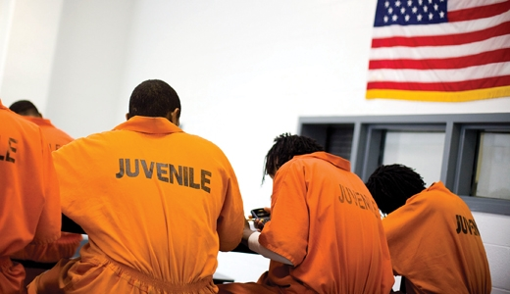
Forensic Child Welfare: Learning Activities
Course related field trips:
Juvenile Court
Juvenile Detention Facility
Regional Child Welfare Conference
Course discussions and writing assignments:
Relate field observations to course theory and practice.
Analyze field observations related to specific issue of interest.
Benefits:
Real-world exposure to social work practice.
Development of specialized area of interest

Slide 29
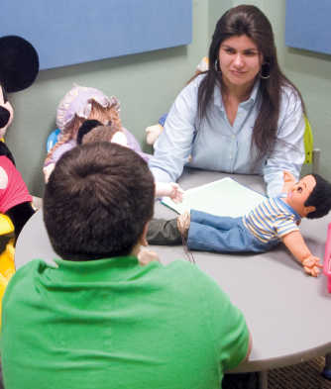
Forensic Child Welfare: Learning Activities
Forensic Interview Role Play:
Lectures and readings related to forensic interview skills.
Students provided with detailed case study. Write a mock interview script.
In-class Role Play:
Required to implement skills through forensic interview in class.
Adapt to various responses from “clients” and receive substantive, real-time feedback from instructor.
Benefits:
Hands-on training in forensic interview skills.
Competence in critical child welfare practice skill.

Slide 30
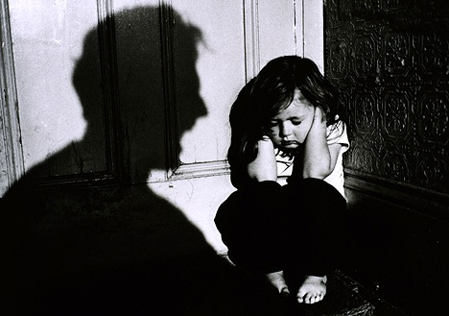
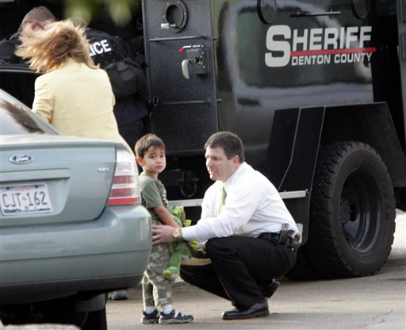
Forensic Child Welfare: Learning Assignments
Individual research projects on legal issues related to child welfare practice:
Research project on a range of substantive legal issues affecting children and social work practitioners.
Research paper and formal presentations on literature review, analysis, and implications for social work practice.
Benefits:
Develop expertise in social policy and legal systems related to child welfare in order to facilitate effective participation in the legal system.

Slide 31
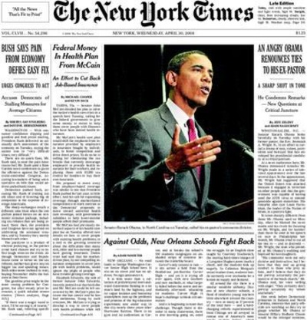
Forensic Child Welfare: Learning Assignments
Content analysis of media coverage related to forensic child welfare:
Analysis of media coverage related to a range of issues relevant to child welfare practice.
Analytical paper relating media coverage to theory, methods and practice of child welfare.
Seven 1-2 pg. reaction papers during term
Benefits:
Encourages broad understanding of the range of issues facing social work practitioners and requires critical engagement with these issues related to practice.

Slide 32
Child Welfare Specialization Practicum
Students have an opportunity to develop, refine and apply generalist practice knowledge, skills, and values while working under supervision in an agency serving children, youth, or families impacted by child welfare law, policy and practice.

Slide 33
Child Welfare Practicum Experience
The overall goal is for the student to be involved in the prevention, assessment, or treatment of children and families experiencing, or at-risk of, child abuse, neglect, or dependency as represented in the learning contract.

Slide 34
Child Welfare Integrative Seminar
Emphasis of the seminar is placed on child welfare practice perspectives both from the vantage point of the professional as well as understanding the experience of the child or family that is being helped.

Slide 35
Discussions and Assignments
Centered on child welfare practice including social work values and ethics, diversity, promotion of social and economic justice, populations-at-risk, human behavior in the social environment, and application of social work practice.

Slide 36
Reflection: Informing Practice Decisions
How do child welfare workers think about their work?
How do child welfare workers generate useful ways of understanding their clients and make decisions about what is helpful?

Slide 37
Learning Assignment
Agency Chart and Agency Presentation
Students are expected to understand agency administrative structure, social work role, and specifics of the agency including purpose, services, procedures for obtaining service, and practice model.
“Added” benefits for students
Knowledgeable of agency practice and skill to link people with systems that provide them with resources, services, and opportunities.

Slide 38
Learning Assignment
Learning Journals
The field practicum journal is designed to guide students through the process of integrating academic and practice learning.
“Added” benefits for students
Enhances the process of reflection/synthesis and increases ability of reflection which is a basis for making informed practice decisions.

Slide 39
Example of Reflective Journaling
Child Welfare Knowledge Base. What have you learned about the philosophy of child protective services within your agency? What general knowledge are you learning in reference to recognizing child abuse and neglect? What knowledge are you gaining in reference to the different forms of violence? What knowledge are you learning about the assessment and intervention approach in your agency? What are you learning about the need to expand existing knowledge about program effectiveness in reference to child welfare practice?

Slide 40
Learning Assignment
Ethical Dilemma Paper
Students take an ethical dilemma situation from their practice and analyze it utilizing the ETHIC Decision-Making Model developed by Congress (1999).
“Added” benefits for students
Enhanced knowledge and skills to engage in effective decision making as every decision in social work practice includes ethical aspects.

Slide 41
Learning Assignment
On-line and in-class discussions
Students are engaged in understanding current literature on child welfare issues.
“Added” benefits for students
Facilitate students making intellectual connections with each other, value and have empathy towards different viewpoints, and improve communication skills.

Slide 42
On-Line and In-Class Discussions
The purpose of class discussions are: (1) to engage you in the current literature on child welfare issues, (2) to facilitate students making intellectual connections with each other, (3) to value different viewpoints and increase empathy towards different viewpoints, and (4) to improve communication skills. You will be expected to read several articles and course notes on a particular child welfare topic. You are to talk with your practicum supervisor and obtain readings from them that will help you in developing your knowledge of practice within your agency. You should obtain a combination of books and journal articles. You will post a discussion concerning your viewpoint about the topic within the expected timeframe (the professor will respond to each student’s viewpoint). You will be expected to read two of your classmate’s discussions and respond to their viewpoint about the topic. Please make sure that your discussions are substantial in content and length.

Slide 43
Learning Assignment
Case Study and Consultation
Students will complete an assessment, intervention plan, and evaluation of an assigned case.
“Added” benefits for students
Enhance ability to communicate an assessment and intervention plan of a client situation to a group of colleagues.
Learn how to engage and value the process of consultation.

Slide 44
Learning Assignment
Philosophy Paper
The paper serves as a way for students to demonstrate the link between theory and practicum experience.
“Added” benefits for students
Opportunity for the student to analyze her/his own practice with a view to enhancing knowledge and skill development.

