Slide 1
Merging Competencies, Content, and Evaluation
Mary L. Pfohl, M.S.W., Ph.D., L.I.S.W.
Associate Professor, St. Cloud State University
Visiting Professor, Center for Advanced Studies in Child Welfare

Slide 2
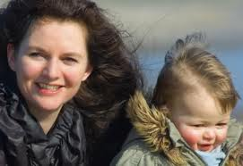
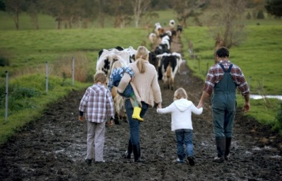
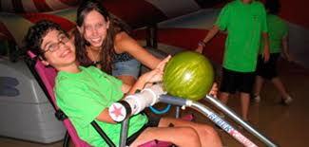
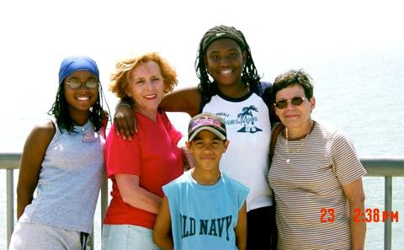
Today’s agenda
Context of child welfare education at SCSU & MN
Competency Development
Competency knowledge assessment
Pilot results and next steps
Discussion

Slide 3
Context - Child Welfare at SCSU
BSW Program
Generalist Practice
EPAS 10 core competencies & 41 practice behaviors
45 credit major
4 semesters
40 Graduates per semester
Commuter university

Slide 4
Context - Child Welfare at SCSU
Child Welfare Program
2 to 3 students per cohort (10 to 12 total)
Required child welfare course (3 credit)
Child welfare learning in social work courses
Supplemental curriculum for each cohort group

Slide 5
Competency Development
CASCW/U of M – EPAS Advanced Competencies
Graduate level
Source information: current syllabi, CALSWEC competencies, MCWTS, community and key stakeholder and student focus groups.
Knowledge and Skill Competencies
MSW and BSW/Advanced & Foundation Competencies
Source information: CALSWEC competencies, EPAS framework, contract for Title IV-E, and course/cohort syllabi
Finalized proposal with MN-DHS and Universities

Slide 6
Competency* Categories
Diversity and Cultural Competence
Engagement
Partnering and Collaboration
Assessment
Case Planning in Child Welfare
Implementing Child Welfare Services
Communications and Documentation
Evaluation
Advocacy
Policy
Supervision and Management
Professionalism in Child Welfare
*links to practice behaviors

Slide 7
Competencies & Educational Level
Foundation
Advanced
BSW graduates = MSW first year
Generalist social work practice focus
Clinical
Supervision and management

Slide 8
Assessment & Evaluation
KNOWLEDGE assessment vs. SKILL assessment
MSW Consortium Work Group
Designed as pre/post assessment
Question development for each competency and practice behavior
Implementation

Slide 9
BSW Child Welfare Knowledge Assessment
Assessment development
Guidebook development
Statewide competencies
Build on groundwork of Graduate level assessment development
Assure congruence with BSW level
Pilot assessment with 9 students (cohort group breakdown: C2 – 4; C3 – 4; C4 – 1)
Complete “cross walk” in competencies and placement within education.
Identify child welfare knowledge gaps in social work coursework & MCWTS.
Develop child welfare cohort curriculum to enhance existing coursework and fill gaps.

Slide 10
Results from Pilot
Regarding topic areas for questions
Regarding question “type”
Students’ greatest comfort to respond
Cultural competence
Engagement
Related to recognition of topics
Students’ greatest challenges to respond
ASFA questions
Generally policy – strength of knowledge recognized
HBSE questions – especially human development questions, students with psychology minor state these areas doable and attributed it to the crossover student between psych and social work
Ability to move between question types
Frustrating experience to jump between the different question types,
Knowing topic area
Case scenario challenging
Clarity of wording
Questions were challenging. “Thought I knew the answers”
Scenario questions easiest
ICWA was workable as it was fresh in the mind.
Multiple choice questions were preferable.

Slide 11
Results from Pilot
Administration of assessment
Influence on studies
Time allotment
90 minutes
“poor test-takers” needed 2 hours
Location
Despite flexibility NOT at home
Need quiet/uninterrupted time
Method
Challenges with D2L – question formatting
Prefer paper/pencil
Prefer immediate feedback
Motivation as child welfare scholar
Excited & open re upcoming content.
Prefer assessment in C1 get more of a sense of what [learning] was going to be presented
“long way to go”
Study in social work courses
Refreshed memory of social work topics and information.
After assessment went back for review.
Assessment preparation to take [social work] licensing exam.
Good to know knowledge could be applied somewhere.

Slide 12
Results from Pilot (cont.)
Other comments & observations
Measurement of child welfare social work knowledge
Complexity of child welfare social work in completing the assessment
Timing of assessment would be important – very beginning and end of education
Use of acronyms – is it necessary?
Overall felt the questions asked were good.
Felt like a “test” – want to do well
Student consensus it measured their level of knowledge
Mean score 6.6 (scale of 10)
Two students identified as poor test takers conveyed greater anxiety

Slide 13
Recommendations & Next Steps
“Clean up” lay out
Convey assessment of program not student
Proceed with implementation for all BSW schools
Address administration: central site, question format, individual school access
Data analysis at individual school and consortium level

Slide 14
Discussion
questions, comments, observations, sharing

Slide 15
Sample Assessment Questions
[2.1.4/1e] Recent immigrants in the United States have the same opportunities to access all social services programs as those who were born in this country. True or False?
[2.1.10(a)/2a] When assessing a family’s risk and learning family history, the best resource for this information is:
Previous case record notes
Members of the family involved
Collateral agency service providers who have worked with the family in the past
Friends, extended family and social supports identified by the family.

Slide 16
Sample Assessment Questions
2.1.7/2g] After being placed in out of home care, Bonnie began to frequently act out violent scenes with her dolls and pretended to be a mother who did not want her children. This response is likely a result of Bonnie’s developmental level and response to life events. Aside from these identified emotional behavioral symptoms, what are other area(s) of Bonnie’s life may be impacted by involvement with the child welfare system?
Forming secure attachment
Academic success
Quality of relationships with siblings or caregivers
Engagement in music and sports activities
A and C
All of the above

