Slide 1
Leveraging private partnerships to enhance IV-E education and training
Title IV-E Roundtable
June 4, 2015
Bloomington, MN
Amelia Franck Meyer & Traci LaLiberte

Slide 2
Our partnership
Amelia Franck Meyer, MS, MSW
Traci LaLiberte, Ph.D.
CEO, Anu Family Services
2233 University Ave W
Suite 325
St. Paul, MN 55114
612.940.0061 (cell)
afranckmeyer@anufs.org
@alfranckmeyer
www.anufs.org
Executive Director Center for Advanced Studies in Child Welfare University of Minnesota 1404 Gortner Ave. 205 Peters Hall St. Paul, MN. 55108 612.624.2279 lali0017@umn.edu
www.cascw.umn.edu

Slide 3
Overview
Introductions
History between Anu Family Services & the Center for Advanced Studies in Child Welfare
Lessons learned in working together
Successes
Challenges
Budgeting
The advantages of partnership
Examples of our work together

Slide 4
History of our Partnership
Center for Advanced Studies
in Child Welfare
University of Minnesota
Anu Family Services

Slide 5
Lessons learned in working together
Successes:
Leveraging capacity and resources
Creating practice-based tools for the field
Adding to the knowledge base of the field
The credibility factor
Others
Challenges:
Ownership, external sale, and “credit”
Understanding and integration
Staffing
Others

Slide 6
Budgeting
50% IV-E match rate
Pressure on Anu to continue to prioritize the partnership work.
Continuing the momentum of innovation, despite funding challenges (e.g., doing R & D before the funding is secured)
Differences in fiscal years and planning cycles

Slide 7
The advantages of partnership
Creates a direct connection between the practice field, training and research
We (both partners) increase our own knowledge of community-based organizational capacity, child welfare workforce challenges, and we are then able to disseminate and share that knowledge with others.
Continue to enhance training capacity for the broader array of eligible professionals, thanks to Fostering Connections
We are each other’s cheerleaders across the country. It is wonderful to have someone in your corner who can speak to your strengths while also pushing you to do better.
We learn from each other in a variety of ways.
Aids in fulfilling organizational mission for both entities

Slide 8
Well-being Indicator Tool for Youth (WIT-Y)

Slide 9
The Youth Connections Scale

Slide 10
Creating a Permanence Driven Organization

Slide 11
Leap Year Study

Slide 12
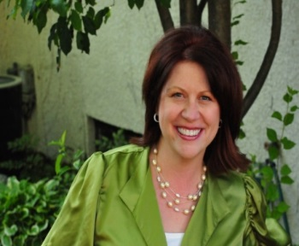
Questions & Comments
Alone we can do so little, together, we can do so much.
–Helen Keller

