Slide 1
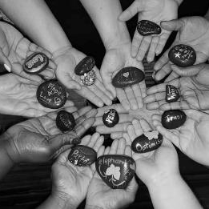





Relationships Matter:
Building Birth and Foster Parent Partnerships that Last
April 20, 2022
BIRTH AND FOSTER PARENT PARTNERSHIP
Notes:
SLIDE 1
Robyn (1 minute )
TRISH TO RECORD THE SESSION AND SAVE THE CHAT
9am PT
11am CT
12pm ET
Robyn -Welcome to today’s Birth and Foster Parent Partnership Workshop (also known as the BFPP) - Relationships Matter: Building Birth and Foster Parent Partnerships that Last.
Put the link to the tools in chat box: https://ctfalliance.org/partnering-with-parents/bpnn/resources/#bfpp --- TRISH/Sofia
Pass to Jody to see who is joining

Slide 2
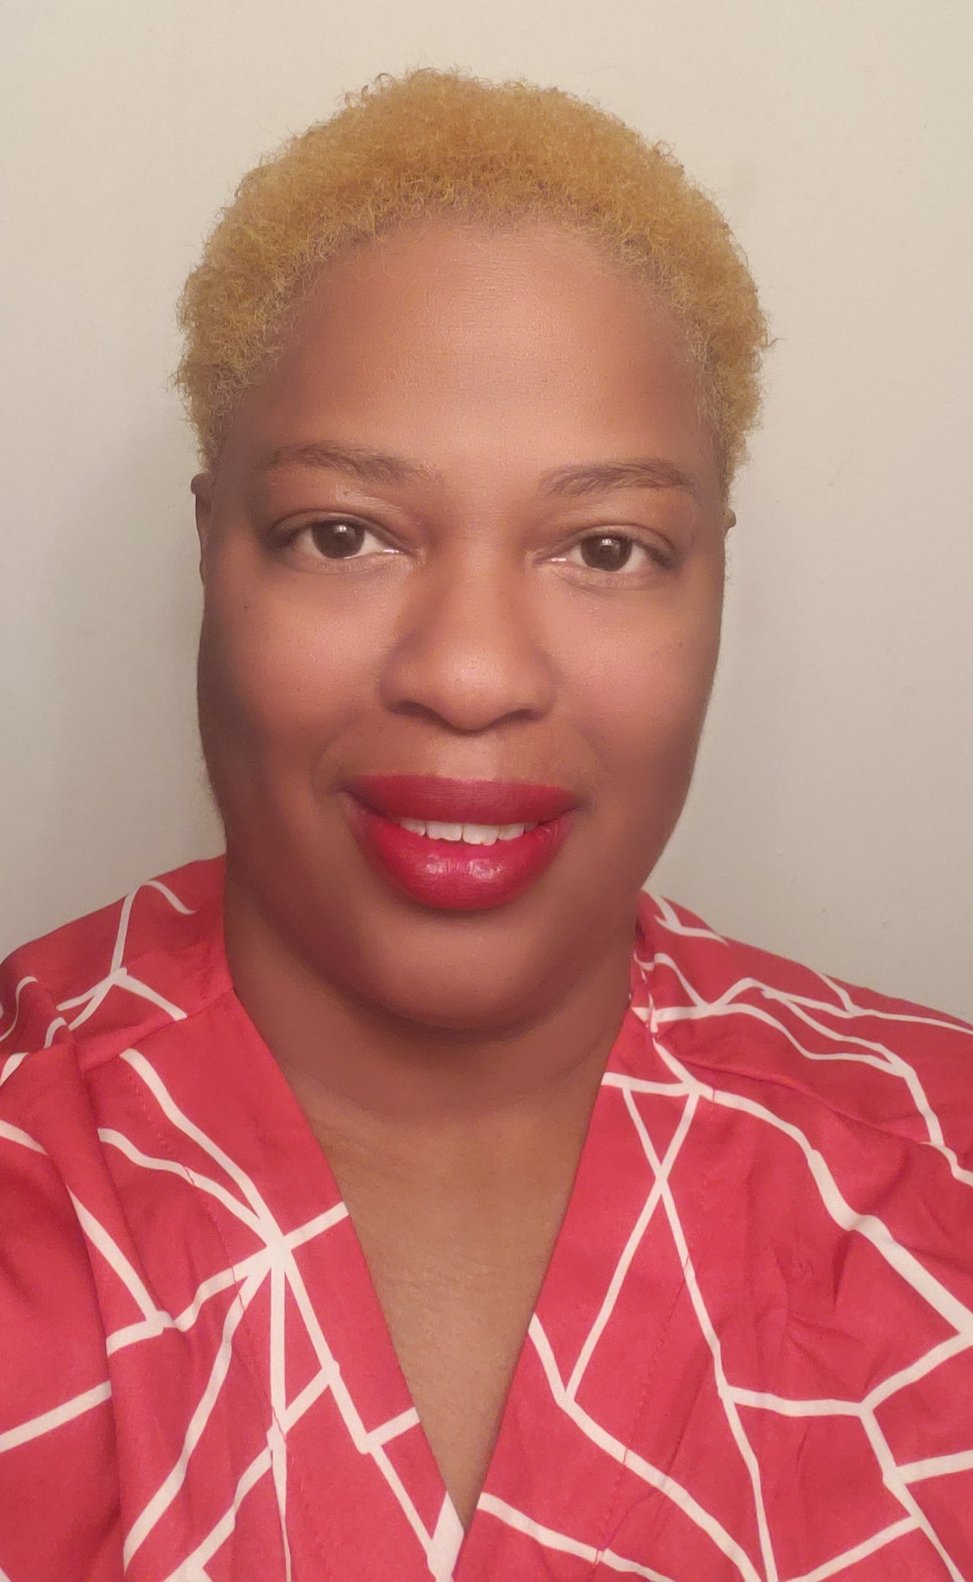
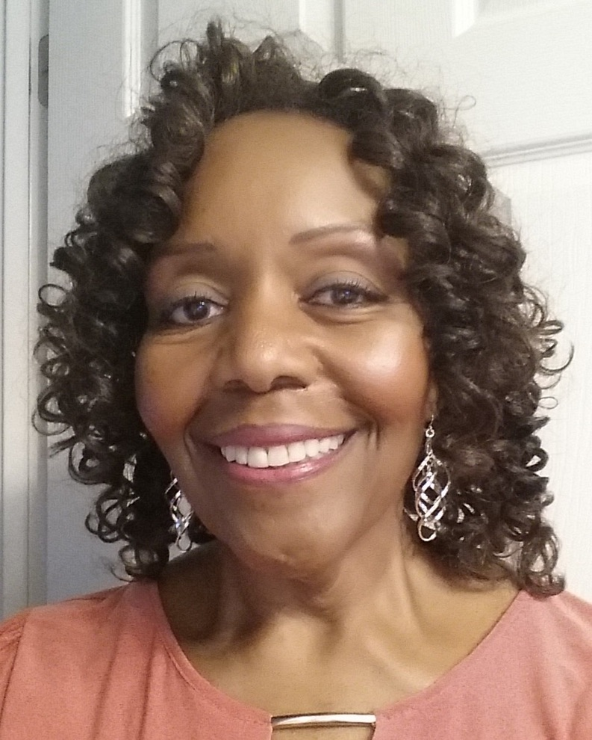
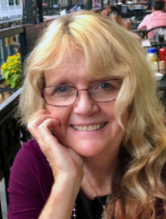

Welcome and Introductions
Paula Bibbs-Samuels
Birth Parent
Texas
Marquetta King
Foster Parent
Maryland
Robyn Robbins
Foster Parent
California
Jody Rodgers
Birth Parent
California
Notes:
Robyn , Jody, Paula, Marquetta (4 minutes)
9:02am PT
11:02am CT
12:02pm ET
Robyn explains that she is joined today with some great co-facilitators and they all are members of the Birth and Foster Parent Partnership National Working Group. She asks each person to:
Introduces themselves – share who they are and their role and why partnerships are important
Each person has 1 minute to share

Slide 3
Agenda
Welcome and Introductions
Workshop Goals
The BFPP Movement and the Tools
The Birth and Foster Parent Partnership: Relationship Building Guide
BFPP Resources and How to Access Them
Notes:
Robyn (1 minute)
9:06am PT
11:06am CT
12:06pm ET
Robyn reviews the agenda
Robyn passes to Marquetta to review the goals of today’s training

Slide 4
Workshop Goals
Gain an understanding of the Birth and Foster Parent Partnership (BFPP) movement
Learn about the BFPP tools
Share the BFPP resources and how to access them
Notes:
Marquetta (3 minutes)
9:07am PT
11:07am CT
12:07pm ET
Workshop Goals
We have three goals that we hope to accomplish during today’s workshop:
Increase your understanding of the Birth and Foster Parent Partnership movement If you are not already a part of the BFPP movement, we hope you will gain a better understanding of what we are all about – we are committed to making changes in the way birth and foster parents and kinship caregivers and staff can work together to build long lasting relationships to help support the children and their families. We hope you will join us in this movement.
2. Introduce you to the two tools that the BFPP members developed. We will introduce you to the Birth and Foster Parent Partnership’s two tools that we created.
(1) A Relationship Building Guide
(2) A State and Local Leader’s Guide to Building a Strong Policy and Practice Foundation
We hope, in turn, that you will get excited about these tools like we are and take them back into your own communities and states and help us in building these important relationships and shift attitudes, policies, practices.
Today, we will be talking more in-depth about the Relationship Building Guide as this will help provide you with a better understanding of how we can begin to build these important relationships between birth parents, foster parents, kinship caregivers and staff.
3. We will be sharing the BFPP Resources with all of you and explain how to access them at the Children’s Trust Fund Alliance website at https://ctfalliance.org/partnering-with-parents/bfpp/
Marquetta passes to Robyn who will share some background about the development of the BFPP and the development of the two tools

Slide 5
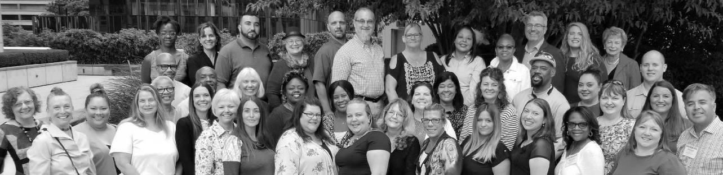
Meet the Birth and Foster Parent Partnership (BFPP)
The new BFPP tools include recommended practices, policies, and implementation tips from birth parents, kinship caregivers and foster parents who have co-parented successfully and who have learned from their own experiences what practices and policies work to help them co-parent well.
Notes:
Robyn (2 minutes)
9:10am PT
11:10am CT
12:10pm ET
Robyn shares that the Birth and Foster Parent Partnership (BFPP) was created in 2016 by 3 partnering organizations, Casey Family Programs, The Children’s Trust Fund Alliance and the Youth Law Center/Quality Parent Initiative
She explains that over the last 5 years our work has focused on developing a powerful national movement of birth parents, foster/resource families, kinship caregivers and staff.
We have and continue to focus on building connections and using our collective voices to transform systems, culture, policies and practices to help improve the lives of children and families.
We created two great tools and a number of resources to help promote their use by child welfare systems, foster care agencies, birth parents, resource/kinship caregivers and a wide range of staff.
Today we will highlight the tools and strategies that make it possible to begin building these important relationships

Slide 6
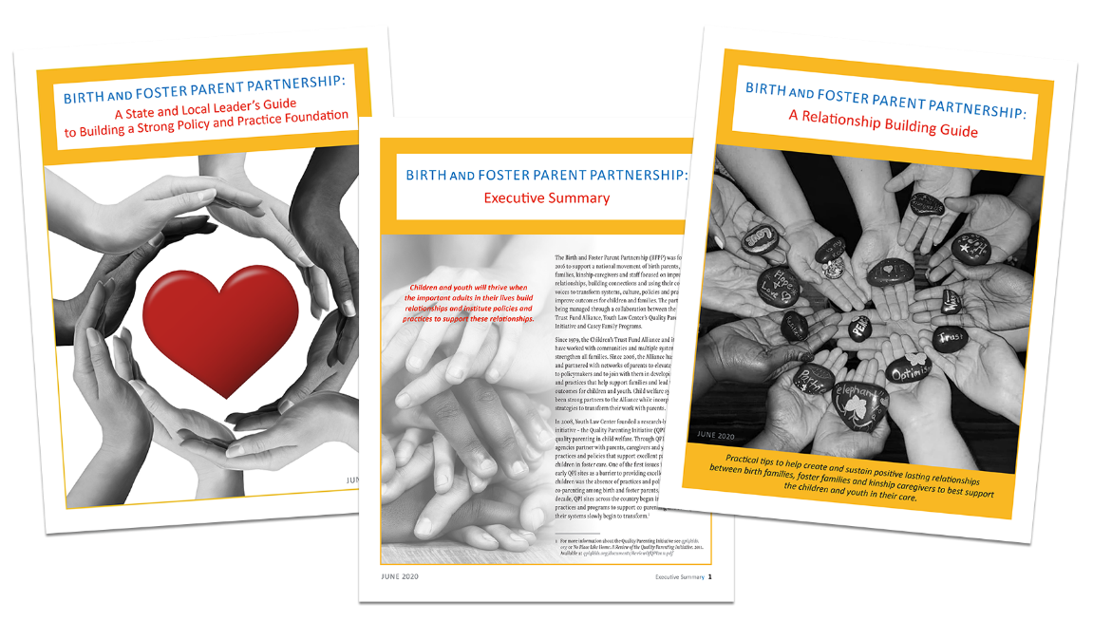
Introducing the BFPP Tools
Notes:
Robyn (2 minutes)
9:12am PT
11:12am CT
12:12pm ET
Robyn provides a brief description of the tools
The BFPP has consistently focused on promoting lasting relationships between birth and foster families and kinship caregivers to support children and families. We worked hard to create two complementary tools to assist in promoting this shift in attitudes and practices.
1. BFPP Relationship Building Guide is most useful for birth, foster parents/kinship caregivers and staff working to build and sustain relationships and work toward reunification whenever possible. It highlights four stages of relationship building and we will be talking about these stages very shortly.
The BFPP State and Local Leaders Guide to Building a Strong Practice and Policy Foundation is most useful for staff and administrators working to create systems that will best support these relationships. It highlights key elements of culture change, promising practices and policies and implementation strategies.
We also created an Executive Summary that provides a brief overview of the BFPP and these two new tools
Robyn pass to Paula to share how she is doing this work in her state.

Slide 7
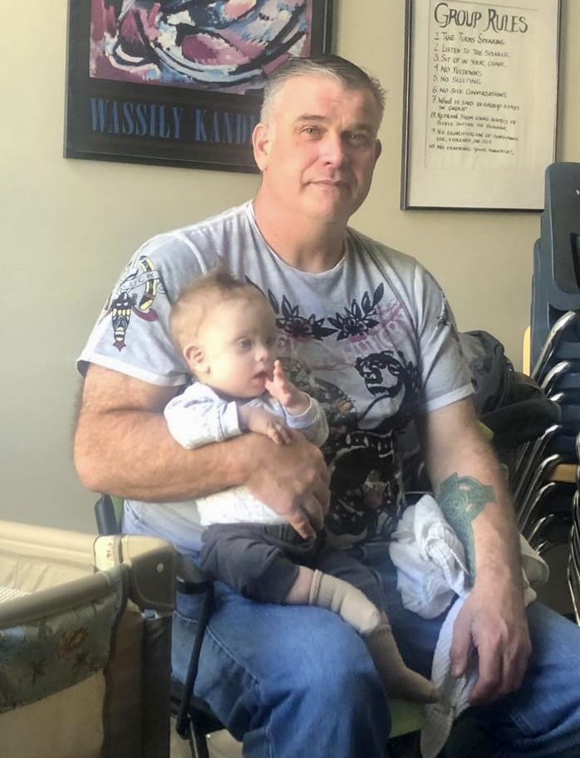
“I believe that the strong and supportive relationship that I had with the foster parents helped me work towards reunification. It made me feel more comfortable to know that my son was in good hands. I was able to speak to the foster parents directly when needed. Even in a heated discussion, they listened.”
Notes:
Paula (3 minutes)
9:14am PT
11:14am CT
12:14 pm ET
Paula shares how she uses the tools in the work she does locally (Paula to explain in her own words)
Paula then states that Robyn will now facilitate a more in-depth discussion on the content in the Relationship Building Guide.

Slide 8
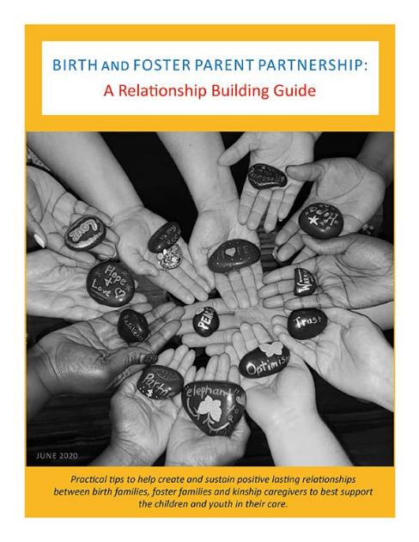
Birth and Foster Parent Partnership: A Relationship Building Guide
Addresses how birth parents and foster parents/kinship caregivers can build stronger relationships.
Describes how agency leaders can incorporate the tool.
Notes:
SLIDE 9
Robyn (1 minute)
9:17am PT
11:17am CT
12:17 pm ET
Robyn - The Relationship Building Guide Includes recommendations from and for birth parents and foster parents/kinship caregivers on ways they can build a stronger relationship to meet the needs of the child and work collaboratively with the child welfare worker and other service providers.
It is organized with four distinct relationship-building topics followed by a conclusion, glossary and recommended readings and other resources.
1. Building the relationship
2. Supporting the relationship
3. Keeping the relationship strong while working with the system and planning for reunification
4. Keeping the relationship strong after the birth family leaves the system
Four Charts in the Relationship Building Guide - This guide includes four charts with examples of strategies for each of these different stages. You can download the four charts from the Children’s Trust Fund Alliance BFPP webpage and use them as handouts for discussion with different groups.

Slide 9
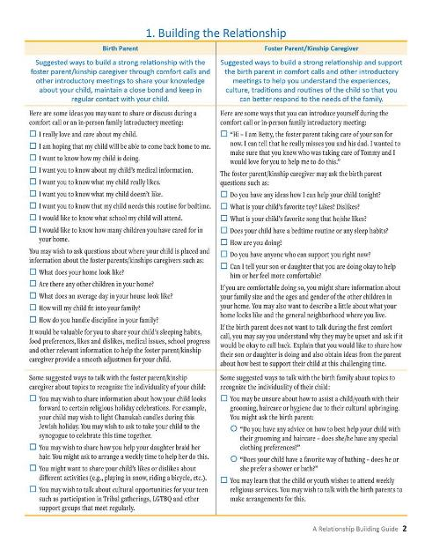
Chart 1.
Building the Relationship
A positive relationship between the birth parent and the foster parent/kinship caregiver can help the child or youth maintain a sense of identity and family history, supports relationships and creates dialogue about the individual needs of the children in care and their families.
Notes:
SLIDE 10
Robyn and Jody (4 minutes)
9:18am PT
11:18am CT
12:18 pm ET
Robyn
This is the first of the four charts - building the relationship.
Robyn and Jody share about an experience with Laura using a strategy from chart #1
Jody passes to Robyn to introduce chart #2

Slide 10
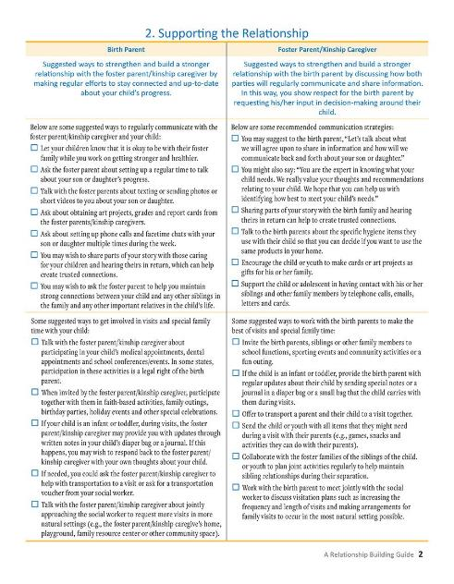
Chart 2.
Supporting the Relationship
Children and youth benefit by feeling safer and learning healthy communication skills when they see the foster parents/kinship caregivers and birth parents working together.
Notes:
SLIDE 11
Robyn/Jody (10 minutes)
9:22am PT
11:22am CT
12:22pm ET
Robyn -- This is the second chart – Chart #2 – Supporting the Relationship- Robyn sets the stage by stating that Children and youth benefit by feeling safer and learning healthy communication skills when they see the foster parents/kinship caregivers and birth parents working together.
Robyn states that it is time for a role play and mentions the possibility of emotional reactions:
Robyn sets the stage:
BP runs in to visit out of breath and late for her visit for the second time. FP asks SW if she can talk to BP for a minute at the end of the visit…
After the role play Robyn and Jody share about their experience.
Robyn states: When both the foster parent and the birth parent work together, children realize that they do not have to choose one family over another and that adults can get through difficult situations by communicating with and supporting each other.

Slide 11
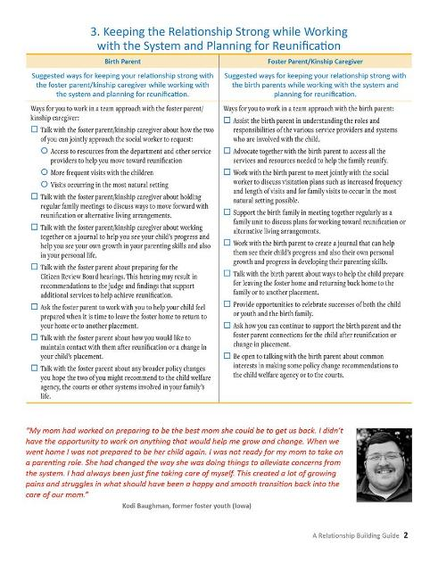
Chart 3.
Keeping the Relationship Strong while Working with the System and Planning for Reunification
It is important for the birth family and the foster parent/kinship caregiver to keep their relationship strong by working as a supportive and unified team and sharing consistent information about the child or youth with the other professionals who may be involved in working with the family.
Notes:
SLIDE 12
Robyn and Paula (3 minutes)
9:32am PT
11:32am CT
12:32 pm ET
Robyn
This is the third chart - Keeping the relationship strong while working with the system and planning for reunification
Paula shares an example/experience using a strategy from chart #3
Paula passes back to Robyn -
Keeping the relationship strong while working with the system involves creating a collaborative effort with everyone supporting the family in working toward reunification.

Slide 12
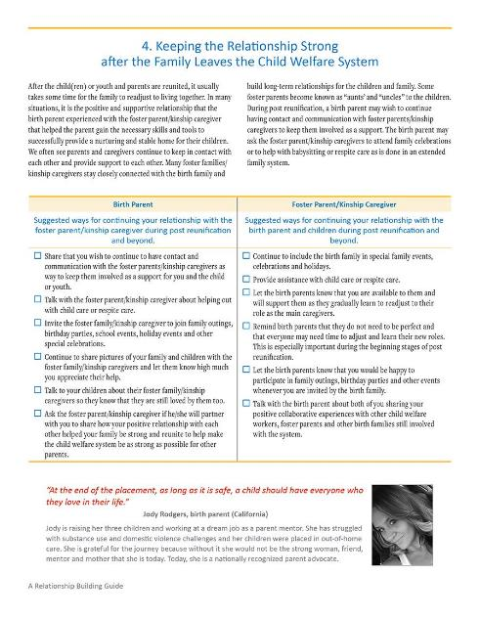
Chart 4.
Keeping the Relationship Strong after the Birth Family
Leaves the System
Many foster families/kinship caregivers stay closely connected with the birth family and build long-term relationships for the children and family.
Notes:
SLIDE 13
Robyn and Marquetta (5 minutes)
9:35am PT
11:35am CT
12:35pm ET
Robyn introduces chart 4
This is the fourth chart – Keeping the relationship strong after the birth family leaves the system.
Robyn introduces Marquetta who shares an example/experience using a strategy from chart#4.
Marquetta turns it back to Jody to share her quote.
Jody shares the importance of lasting relationships for children and their families and ends with her quote. Jody passes to Robyn for resource slide

Slide 13
BFPP Resources and Access to Them ctfalliance.org/partnering-with-parents/bfpp
Relationship Building Tools
Executive Summary
BFPP Flyer to Promote the Tools
Handout with Recommendations on How to Use the Relationship Building Guide
Handouts of Charts on Relationship Building Stages
Relationships Matter Workshops (videos coming soon!)
Notes:
SLIDE 14
Robyn (2 minutes)
9:40am PT
11:40am CT
12:40pm ET
(Trish/Sofia put link to evaluation in the chat box)
Robyn highlights all of the BFPP resources and how to access them. All can be found and downloaded at ctfalliance.org/partnering-with-parents/bfpp
We have a one-page Executive Summary that offers a quick overview of the BFPP and the two guides.
We also created a generic flyer about the BFPP and the tools that you can download and disseminate to others.
We have a handout with recommendations on how to use the Relationship Building Guide
We have handouts of various charts on relationship building stages that can be used to stimulate discussions among staff, foster parents, foster parent associations, parent partners and other groups
You can access all of these materials at….ctfalliance.org/partnering-with-parents/bfpp
evaluation

Slide 14
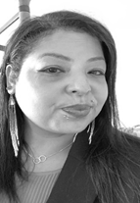
"A strong relationship between a birth parent and foster parent can make a huge difference for a child and their birth family. I think it is awesome to know that your child is safe. I especially appreciate that the foster parent wants to know what practices I use to care for my child. I also have some comfort knowing that the foster parent cares about me. In this way, I can move forward with my own healing and also work on a plan for a better life for me and my family."
Shana Hunts Along, birth parent (Minnesota)
Notes:
SLIDE 15
Robyn (1 minute)
9:42amPT
11:42amCT
12:42pm ET
This is a quote from a great birth parent that is included in the Relationship Building Guide.
She describes how important the foster parent relationship and support can be.

Slide 15
Questions and Further Discussion reach out to Sofia Santillana@ sofia.santillana@ctfalliance.org
Notes:
SLIDE 16
Robyn (1-7minutes)
9:43am PT
11:43am CT
12:43pm ET
Questions and Answers- Robyn
Because we don’t have time today, we would like to let you know both the presenters and the folks at the alliance are available for any questions or comments you would like to share.
Robyn thanks Casey Family Programs, QPI and The Children’s Trust Fund Alliance for their support for the BFPP, the presenters and support team and the participants for joining us today!
Trish saves recording and chat.

